Slide 1
Introduction to
International Business Administration

Slide 2
Ethics in International Business
Notes:
This is a test

Slide 3
Prof. Dr. Amit Shah
Notes:
This is a test

Slide 4
Ethics in International Business
Know the difference between culture and ethics!
Ethics may be influenced by culture, but all culture does not include ethics.
Notes:
Ethics = what is right or wrong

Slide 5
Ethics in International Business
Objectives
  Source of ethical challenges in IB
  Effect of ethical challenges on decisions in IB
  Causes of poor ethical decisions in IB
  Different conceptual underpinnings for ethical decisions in IB
  What managers can do to
    Promote an awareness of ethical issues throughout the organization
    Ensure that ethical considerations enter into decision making

Slide 6
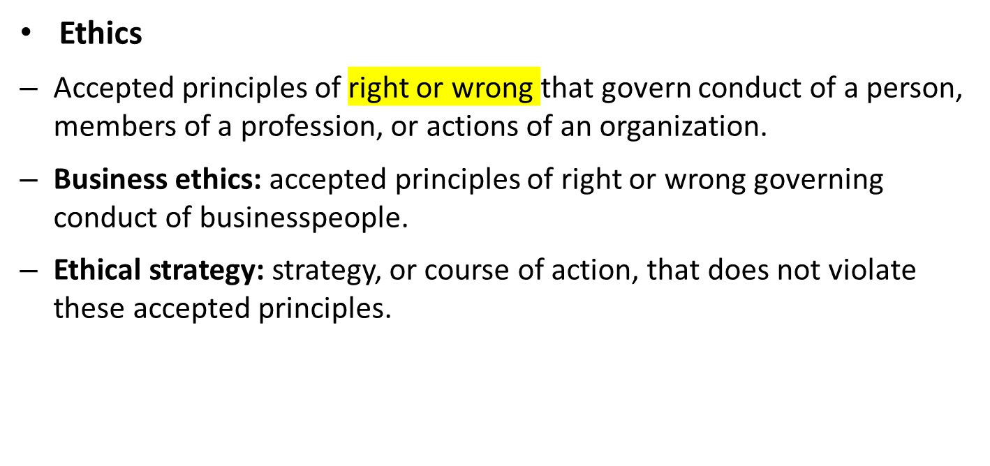
Introduction
Notes:
Ethics, corporate social responsibility, and sustainability are intertwined issues facing countries, companies, and societies. These "social" issues arise frequently in international business, often because business practices and regulations differ from nation to nation

Slide 7
Ethical Issues in International Business
Arise when a manager makes decisions consistent with differing national environments
  Political systems
  Legal systems
  Economic development levels
  Culture
What is ethical and “normal” in one environment may not be so in another?
Notes:
Issues come when managers try to apply their ethics/cultures to other cultures/ethics

Slide 8
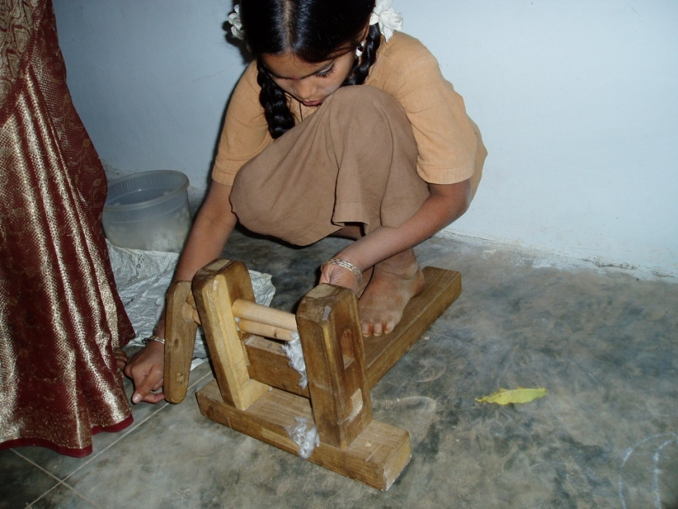
What Would You Do?
An American executive is transferred to a foreign subsidiary in a developing country. He learns that his plant manager has hired a 12-year-old girl to work on the factory floor. Appalled to find that the subsidiary is using child labor in direct violation of the company’s ethical code, the American instructs the plant manager to replace the child with an adult. The manager dutifully complies.
What would you do?
Notes:
You cannot understand situation until you know the stories behind the people

Slide 9
Ethical Issues in International Business
Arise most often in the context of:
  Employment practices
  Human rights
  Environmental policy
  Corruption
  An MNC’s perceived moral obligations to society
►
Notes:
Employment practise (child labour, safety)

Slide 10
Employment Practices
What standards should be applied?
  Home nation’s
  Host nation’s
  Other
Should the MNC adapt its policies? Standardize?
Hiring practices, labor relations, diversity issues, employment conditions are some specific issues that require careful thought
Notes:
Home = where company is from
Host = where the company is operating

Slide 11
Human Rights
Can a manager assume as universal her/his views on freedom of: no
  Association
  Speech
  Assembly
  Movement
  Political repression?
What is the responsibility of an MNC to uphold different standards of human rights?

Slide 12
Repressive Regimes
Is it ethical for MNCs to operate in countries with repressive regimes?
  Is inward investment an agent for change?
  What is the limit beyond which inward investment would not be justified under all circumstances?
  What if competitors from other nations invest and you don’t?
  If you do, and the regime is overthrown, should you be allowed to stay?

Slide 13
Environmental Policies
Locally mandated environmental standards may be inferior to those an MNC knows it can achieve
Tragedy of the commons: a resource held in common by all, but owned by no one, is overused by some, resulting in degradation.
If a decision is legal but unethical, should it be taken?
Notes:
Greenwashing : a company pretends to be enviromentally friendly than they really are
Tragedy of the commons: owned by nobody, but overused/exploited by some → degradation happens
Everything ethical = legal; everything legal = not necessarily ethical

Slide 14
Corruption
Government officials may ask for bribes for an MNC to “get things done”
  Is an MNC’s manager who agrees a corrupt manager?
  Should an MNC ever accede to bribery demands?
Foreign corrupt practices act (USA)
Convention on Combating Bribery of Foreign Officials in International Business Transactions (OECD)

Slide 15
Bribes
Two kinds of bribes
  To get what you are entitled to, but getting it faster or more conveniently.
  To get what you are not entitled to.
Notes:
Facilitating payments

Slide 16
Bribes
Are they equally bad? Are they bad at all?
If either is necessary to enter a desirable market, would you pay them?
Is the size of the bribe important?
What is the difference between a bribe and a gift?

Slide 17

Bribes
German prosecutors named Hewlett-Packard Co. in a criminal bribery case against one current and two former employees, potentially exposing the computer maker to fines. Company executives paid roughly €7.5 million in kickbacks to win a €35 million contract to sell computer gear to Russia's Prosecutor General Office.

Slide 18
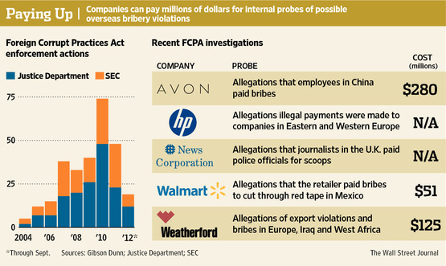
FCPA Actions
Notes:
To cut through the red tape = quicken beaurocracy

Slide 19

What Would You Do?
You are standing in line after arriving by air in a developing country. They are checking your passports. You can see that after they check your passport, you have to stand in a long line to go through customs. The wait appears to be an hour or more. You notice that someone ahead of you puts a folded $20 bill in his passport before handing it to the immigration officer. He is then directed to a much shorter line to go through customs.
What do you do?

Slide 20
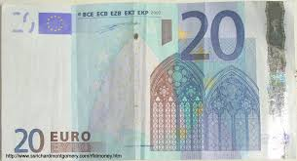
What Would You Do?
You finally arrive at your hotel. You talk to the concierge about your needs during your stay and tip him €20 with a promise of another €20 if everything goes well.
Is what you did proper?

Slide 21

What Would You Do?
You take a taxi to the office of the government official with whom you are negotiating a contract. You notice a line item “unknown unknowns” with a dollar amount of about 10 percent of the contract. You ask about it. You are told it is for unanticipated expenses. You ask if the money is refunded to you if there are none. You are told that the minister of defense controls these funds, and their use is at his discretion. Without these funds, you don’t get the contract.
What would you do?

Slide 22
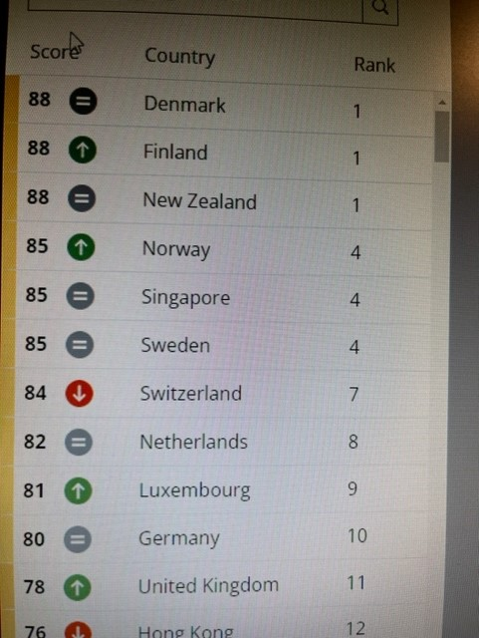
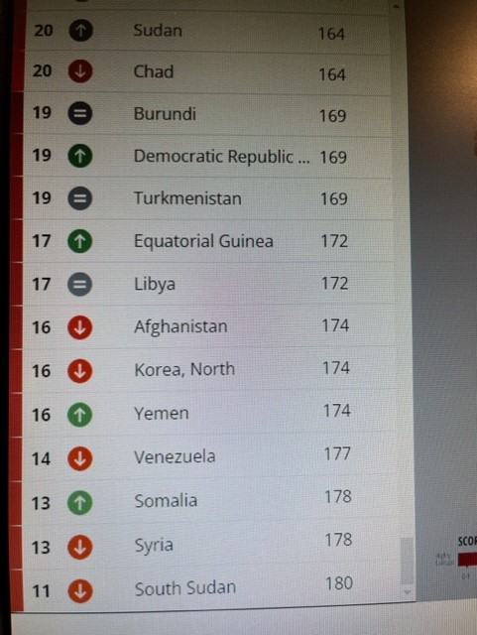
Corruption –Least and Most -- 2021
Source: Transparency International

Slide 23
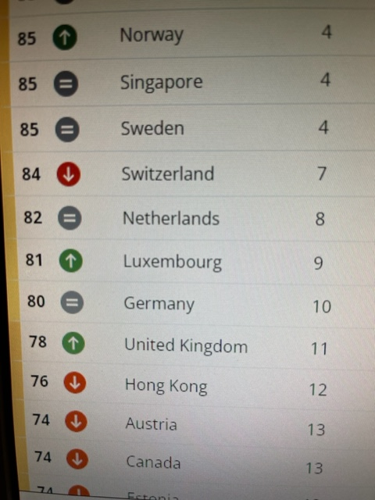
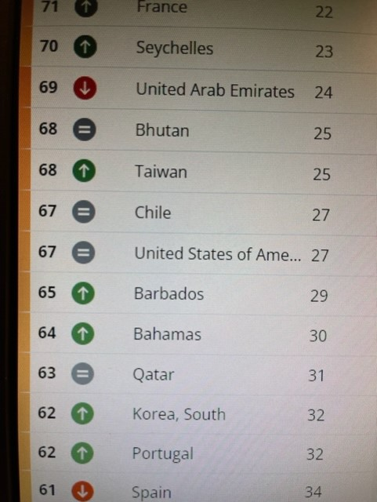
Corruption –Germany and USA--2021

Slide 24
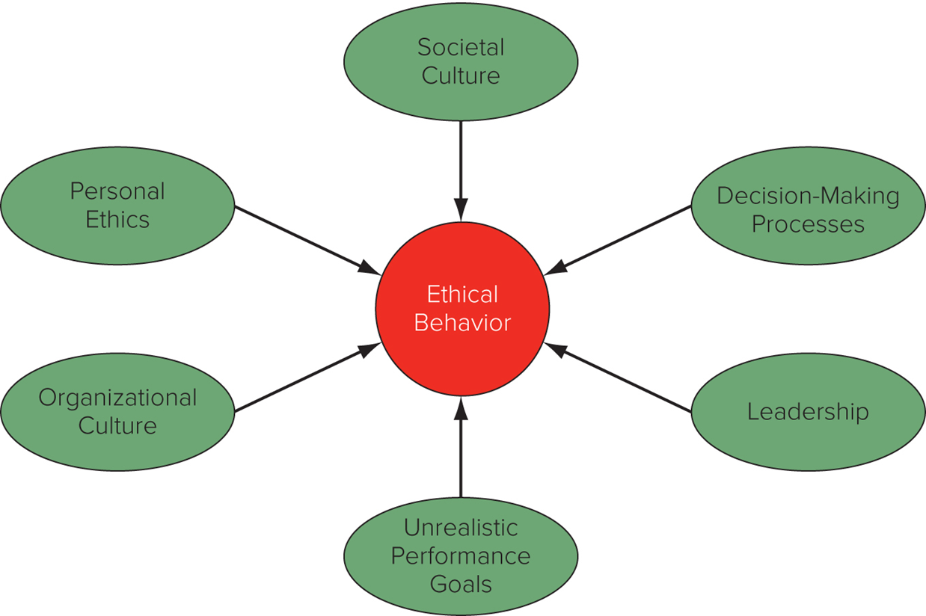
Determinants of (Un)ethical Behavior

Slide 25
Roots of Unethical Behavior
Personal Ethics
  Business ethics reflect personal ethics.
  Expatriates may face pressure to violate personal ethics.
    Away from ordinary social context and supporting culture.
    Psychologically and geographically distant from parent company.
Decision-Making Processes
  Businesspeople may behave unethically because they fail to ask relevant questions.
  Decisions made based on economic logic.
Notes:
Personal ethics refer to the generally accepted principles of right and wrong governing the conduct of individuals.
To improve ethical decision making in a multinational firm, the best starting point is to better understand how individuals make decisions that can be considered ethical or unethical in an organizational environment. Two assumptions must be taken into account. First, too often it is assumed that individuals in the workplace make ethical decisions in the same way as they would if they were home. Second, too often it is assumed that people from different cultures make ethical decisions following a similar process. Both of these assumptions are problematic. First, within an organization, there are very few individuals who have the freedom (for example, power) to decide ethical issues independent of pressures that may exist in an organizational setting (for example, should we make a facilitating payment or resort to bribery?). Second, while the process for making an ethical decision may largely be the same in many countries, the relative emphasis on certain issues is unlikely to be the same.

Slide 26
Roots of Unethical Behavior
Organizational Culture
  Unethical behavior may exist in firms with an organizational culture that does not emphasize business ethics.
  Values and norms shape the culture of a firm, and that culture influences decision making.
Unrealistic Performance Goals
  Pressure from parent company to meet goals that are unrealistic and can only be attained by acting in an unethical manner.
    Ex: Wells Fargo
Notes:
The term organizational culture refers to the values and norms that are shared among employees of an organization.
The combination of an organizational culture that legitimizes unethical behavior, or at least turns a blind eye to such behavior, and unrealistic performance goals may be particularly toxic.

Slide 27
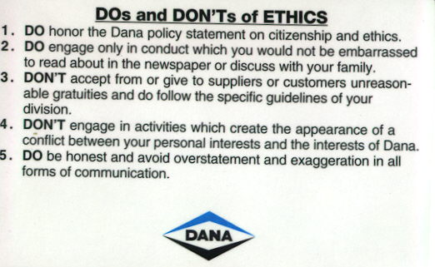
Dana Guide to Ethical Behavior

Slide 28
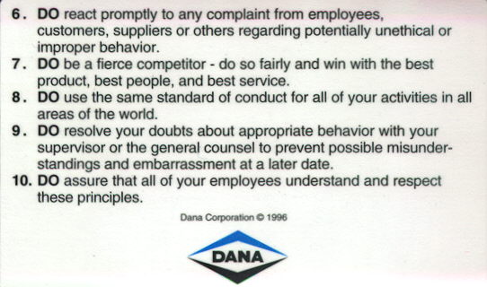
Dana Guide to Ethical Behavior

Slide 29
Morgan Stanley Guide to Ethical Behavior
Five Questions to Ask:
Is my action legal?
Is my action consistent with this code, our policies and Morgan Stanley’s commitment to integrity?
Could my action be perceived as inappropriate or unethical?
Could my action damage my or Morgan Stanley’s reputation, or embarrass me or Morgan Stanley?
How would my action appear as a headline in tomorrow’s newspaper?

Slide 30
Roots of Unethical Behavior
Leadership
  Leaders establish the culture of the organization and set the example.
  Actions speak louder than words.
    Ex: Southwest Airlines
Societal Culture
  Ethical policies differ by country.
  M N Es located in countries with strong individualism and uncertainty avoidance are more likely to emphasize ethical behavior.
  M N Es located in countries with high masculinity and high power distance are less likely to promote ethical behavior.
Notes:
Employees often operate and work within a defined structure with a mindset very much similar to the overall culture of the organization that employs them.

Slide 31
Philosophical Approaches to Ethics
Straw Men: 1) The Friedman doctrine, 2) Cultural relativism, 3) Righteous moralist, and 4) Naive immoralist
Utilitarian and Kantian Ethics
Rights theories
Justice Theories
Notes:
Straw men:
1) Friendman: business exist to make money; they should not worry about anything else

Slide 32
Philosophical Approaches to Ethics
Straw Men
  The Friedman doctrine states that the social responsibility of business is to increase profits, so long as company stays within rules of law.
    Companies should do only what is mandated by law and what is required to run a business efficiently.
  Cultural relativism: ethics are culturally determined, and firms should adopt ethics of the cultures in which they operate.
    “When in Rome, do as the Romans do.”
Some universal ideas of morality are found across cultures.
Notes:
Straw men approaches are raised by business ethics scholars primarily for the purpose of demonstrating that they offer inappropriate guidelines for ethical decision making in a multinational enterprise.
Critics charge that Friedman’s arguments break down under examination. This is particularly true in international business, where the “rules of the game” are not well established and differ from country to country. As with Friedman’s approach, cultural relativism does not stand up to a closer look. At its extreme, cultural relativism suggests that if a culture supports slavery, it is okay to use slave labor in a country.

Slide 33
Philosophical Approaches to Ethics
  Righteous moralist: M N E’s home country standards of ethics are appropriate for companies to follow in foreign countries.
    Common among managers from developed countries.
    Critics say it is not always appropriate to adopt home-country standards.
  Naive immoralist: if a manager of M N E sees firms from other nations not following ethical norms in host nation, that manager should not either.
    Actions are ethically justified if everyone else is doing the same thing.
Notes:
The main criticism of the righteous moralist approach is that its proponents go too far. While there are some universal moral principles that should not be violated, it does not always follow that the appropriate thing to do is adopt home-country standards.
The objection to the naive immoralist approach is twofold. First, to say that an action is ethically justified if everyone is doing it is not sufficient. Second, the multinational must recognize that it does have the ability to change the prevailing practice in a country.

Slide 34
Philosophical Approaches to Ethics
Utilitarian and Kantian Ethics
  Utilitarian approach to ethics: moral worth of actions or practices is determined by their consequences.
    Actions have multiple consequences, some good, some not.
    Actions are desirable that produce greatest good for greatest number of people.
    You should do what is good for the maximum number of people
  Kantian ethics: Immanuel Kant argued that people should be treated as ends and never purely as means to the end of others.
    People have dignity and need to be respected; they are not machines.
Notes:
The utilitarian philosophy does have some serious drawbacks as an approach to business ethics. One problem is measuring the benefits, costs, and risks of a course of action. The second problem with utilitarianism is that the philosophy omits the consideration of justice.
Although contemporary moral philosophers tend to view Kant’s ethical philosophy as incomplete—for example, his system has no place for moral emotions or sentiments such as sympathy or caring—the notion that people should be respected and treated with dignity resonates in the modern world.

Slide 35
Philosophical Approaches to Ethics 4
Rights Theories (look at human level first)
  Human beings have fundamental rights and privileges that transcend national boundaries and culture.
  Human rights form basis of moral compass that managers should navigate by when making decisions that have an ethical component.
  Idea that some fundamental rights transcend national borders and cultures was underlying motivation for U N’s Universal Declaration of Human Rights.
  Certain people or institutions are obligated to provide benefits or services that secure rights of others.
Notes:
The UN’s Universal Declaration of Human Rights specifies the basic principles that should always be adhered to irrespective of the culture in which one is doing business.
It is important to note that along with rights come obligations. Because we have the right to free speech, we are also obligated to make sure that we respect the free speech of others.

Slide 36
Philosophical Approaches to Ethics
Universal Declaration of Human Rights (UN article 23)
  Everyone has the right to work, to free choice of employment, to just and favorable conditions of work, and to protection against unemployment.
  Everyone, without any discrimination, has the right to equal pay for equal work.
  Everyone who works has the right to just and favorable remuneration ensuring for himself and his family an existence worthy of human dignity, and supplemented, if necessary, by other means of social protection.
  Everyone has the right to form and to join trade unions for the protection of his interests.
Notes:
This excerpt is from Article 23, which relates directly to employment.

Slide 37
Philosophical Approaches to Ethics
Justice Theories
  Focus on attainment of just distribution—one that is considered fair and equitable—of economic goods and services.
  John Rawls: all economic goods and services should be distributed equally except when unequal distribution would work to everyone’s advantage.
  Impartiality is guaranteed by veil of ignorance—everyone is imagined to be ignorant of all their particular characteristics.
    Race, sex, intelligence, etc.
Notes:
Rawls’ veil of ignorance is a conceptual tool that contributes to the moral compass that managers can use to help them navigate through difficult ethical dilemmas.
Veil of ignorance → do not look at outer appearances; hire based on merits/credentials

Slide 38
End of Ethics Lecture

